Slide 1







MY HEALTH PAL
PERSONALIZED CHATBOT WITH DYNAMIC RESPONSES
MY HEALTH PAL

Slide 2




MY HEALTH PAL
Introduction
This project aims to build a Personalized Chatbot with Dynamic Responses using fine-tuning techniques on Hugging Face datasets. The chatbot leverages efficient inference techniques like 4-bit quantization for performance optimization and RoPE scaling to handle extended conversations. We experimented with various model architectures, including Mistral, LLaMA-2, Gemma , and CodeLLaMA.

Slide 3

MY HEALTH PAL
OBJECTIVES
Personalization: Build a chatbot capable of generating dynamic and user-context-aware responses.
Efficient Inference: Use 4-bit quantization to optimize memory usage and increase speed.
Extended Sequence Handling: Implement RoPE scaling to manage longer conversations effectively.
Explore Architectures: Fine-tune and deploy Mistral, LLaMA-2, Gemma and CodeLLaMA models for comparison.

Slide 4


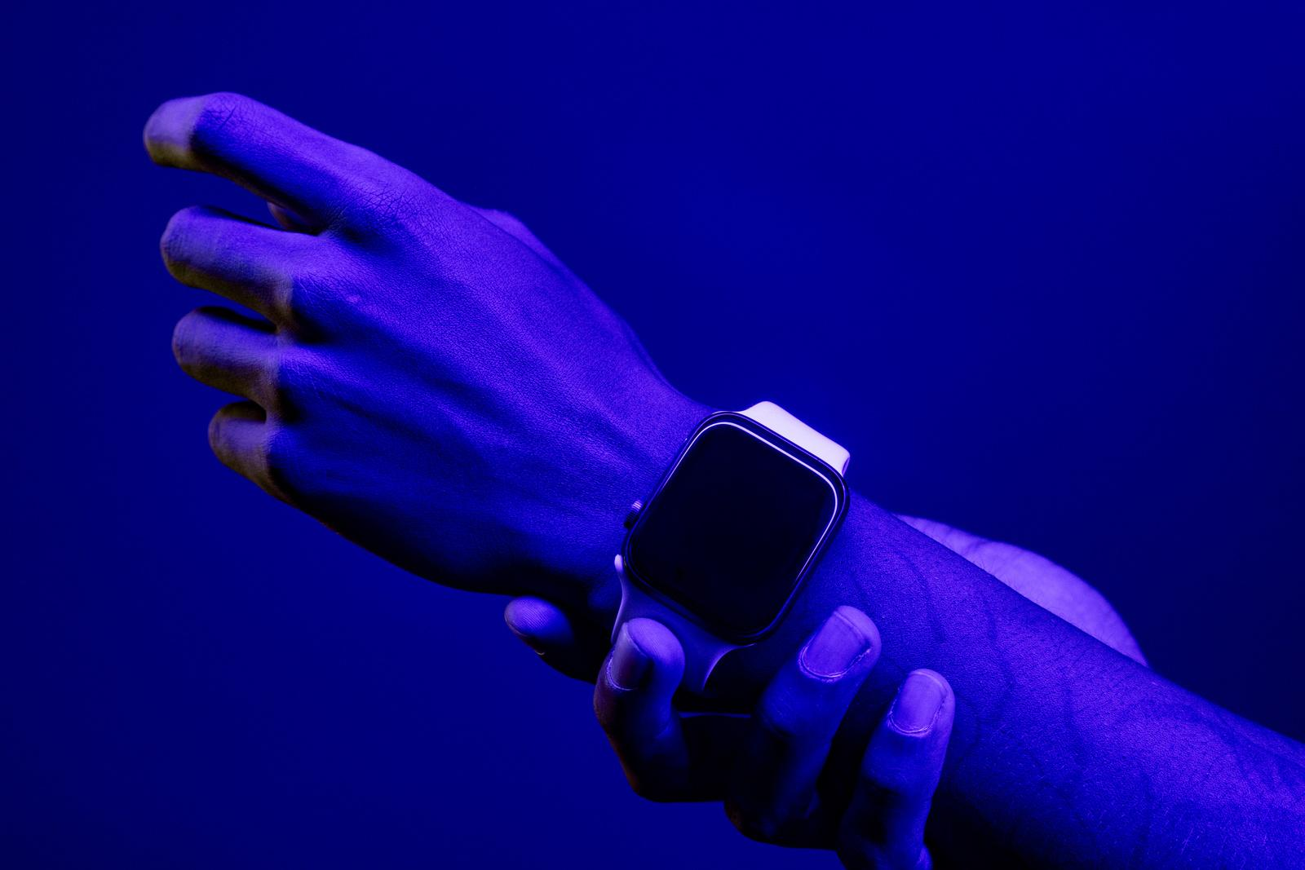

MY HEALTH PAL
PREPROCESSING
METHODOLOGY
Tokenization: Prepared data for the model using Hugging Face tokenizers to ensure the model interprets input properly.
EOS Token Insertion: End-of-sequence (EOS) tokens were added to prevent infinite generation loops during response generation.
MODEL FINE TUNING
Parameter-Efficient Fine-Tuning:
Utilized LoRA (Low-Rank Adaptation) to fine-tune pre-trained models while minimizing computational overhead.
Enabled gradient checkpointing to reduce memory usage during fine-tuning.
Models Used:
Mistral, LLaMA-2, Gemma and CodeLLaMA.
DATA COLLECTION
Alpaca-Cleaned Dataset from Hugging Face.
This dataset, originally based on the Alpaca dataset by Stanford, provides clean, well-structured data for chatbot testing.

Slide 5
MY HEALTH PAL
TECHNICAL OVERVIEW
·Programming Language: Python
·Libraries Used: Hugging Face Transformers, Unsloth, TRL, PyTorch
·Development Environment: Google Colab with Jupyter notebooks
DATASET: MCGILL-NLP MEDAL
Dataset Description: The MEDAL dataset is used for fine-tuning the chatbot, focusing on multilingual and multitask learning scenarios.
Preprocessing: Tokenization and EOS token insertion were applied to avoid infinite text generation.
Usage: MEDAL dataset allowed the chatbot to generate culturally aware, multilingual responses.

Slide 6
MY HEALTH PAL
CHALLENGES AND SOLUTIONS
Dataset Size: The MEDAL dataset was too large to process efficiently.
Solution: We used the Unsloth library to manage loading and reduce memory constraints.
Memory Constraints:
Solution: Implemented gradient checkpointing and 4-bit quantization to reduce memory
usage during training and inference.
Peak Reserved Memory: 6.273 GB
Memory Reserved During Training: 1.773 GB (~12.02% of total system memory).
Dynamic Responses with Constraints: Ensuring the chatbot generates personalized responses while adhering to predefined constraints such as length limits and topic relevance.
Solution: Used prompt engineering and rule-based constraints to guide response generation, ensuring that responses are dynamically adjusted based on the context while adhering to the rules.

Slide 7
MY HEALTH PAL
MODEL ARCHITECTURES AND APPROACHES
Models Used: Mistral, LLaMA-2, Gemma, and CodeLLaMA
Fine-Tuning Process:
1.Loaded pre-trained models.
2.Used parameter-efficient fine-tuning with LoRA (Low-Rank Adaptation).
3.Applied gradient checkpointing for reduced memory usage.
Evaluation Metrics: Response coherence, latency, and BLEU score for linguistic quality.
QUANTIZATION STRATEGY
4-bit Quantization: Reduces memory consumption and speeds up inference.
Implementation: Used the FastLanguageModel API with 4-bit weights.
Impact: Significant reduction in model size, enabling real-time responses without performance degradation.

Slide 8


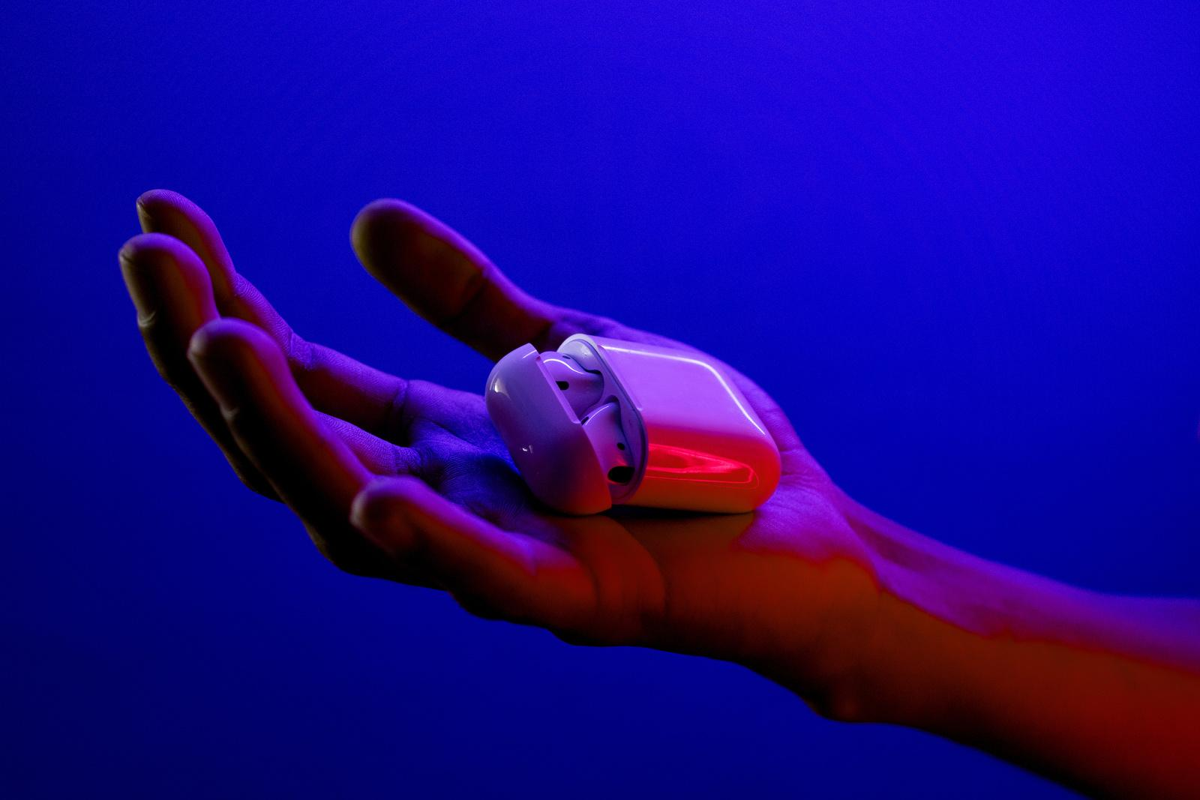
MY HEALTH PAL
Performance Bottlenecks
Performance Bottlenecks: Running large models is often memory and time-consuming, affecting real-time user interaction.
Solution: This project addresses these issues by developing a chatbot capable of dynamic, user-aware responses using fine-tuned, optimized models with improved inference speed and memory efficiency.

Slide 9

MY HEALTH PAL
TESTING AND RESULTS
Training Time:
Total Time: 634.1 seconds (~10.57 minutes)
Training Loss Reduction (across 60 steps):
Initial Loss: 2.7698
Final Loss: 1.7637
Memory Usage:
Peak Reserved Memory: 6.273 GB
Memory Usage During Training: 1.773 GB (~12% of system memory).
RESULT AND IMPACT
80%
RESULT AND IMPACT

Slide 10





MY HEALTH PAL
The project successfully developed a personalized chatbot capable of dynamic responses with optimized memory usage and extended sequence handling. The chatbot also adhered to predefined constraints, improving conversational quality.
CONCLUSION

Slide 11
MY HEALTH PAL
THANK YOU!

